Slide 1

DEPARTMENT OF INFORMATION SCIENCE & ENGINEERING
“VOICE BASED LEARNING ASSISTANT FOR VISUALLY IMPAIRED STUDENT”
Mini Project – 22ISE48
Presentation by,
Kushal K N
1NH22IS075
Mithun Raj Urs T V
1NH22IS086
Under the Guidance of ,
Mrs. Rama
Asst. Professor ISE dept

Slide 2
Agenda
Introduction
Problem Definition
Proposed system
Objectives
Design modules
Implementation
Result (Screen shot)
Conclusion

Slide 3
Introduction
Blood connect will bridge the gap between blood donors and those in need.
It facilitate easy and efficient blood donation processes
Developed using SQLite, CSS, JavaScript and HTML.
The application integrates with the database of donors.

Slide 4
Problem Definition
Difficulty finding donors with matching blood types.
Insufficient donors in specific regions or communities.
Manual searches through social media, hospitals, or blood banks.

Slide 5
Objectives
Connect blood donors and recipients efficiently.
Increase compatible matches and successful transfusions.
Streamline the search and donation process.

Slide 6
Implementation
Home page and user registration page is being developed by using HTML and CSS.
The data is stored and managed by SQL.
Node.js is being used as backend language.
The program is being executed in Node.js which is JavaScript runtime environment.

Slide 7
Design Modules
Donor Registration: User-friendly registration with personal information and blood type.
Donor Search: Advanced search filters (blood type, location, availability) and contact functionality for recipients or their representatives.

Slide 8
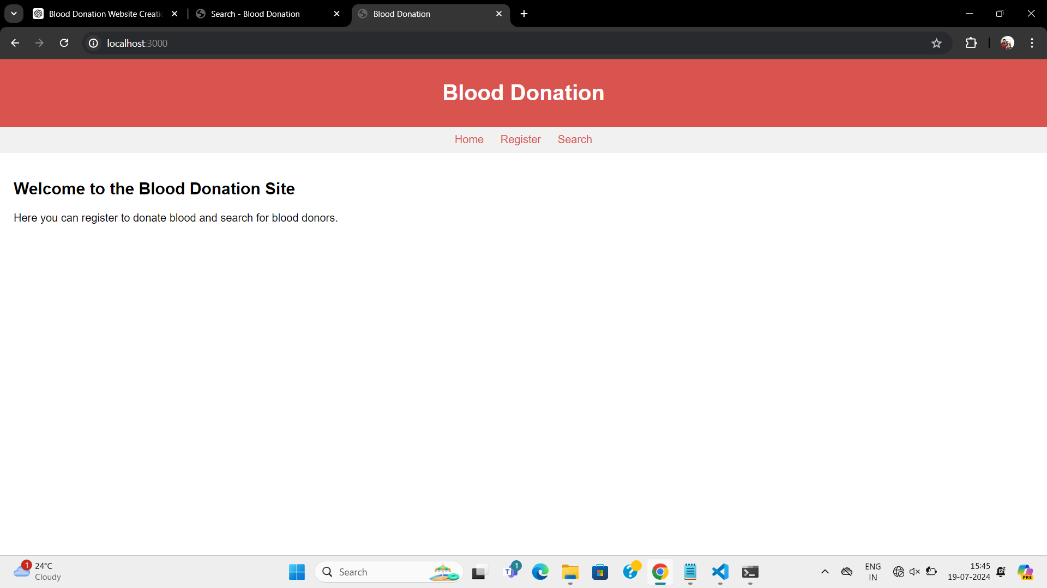
Result

Slide 9
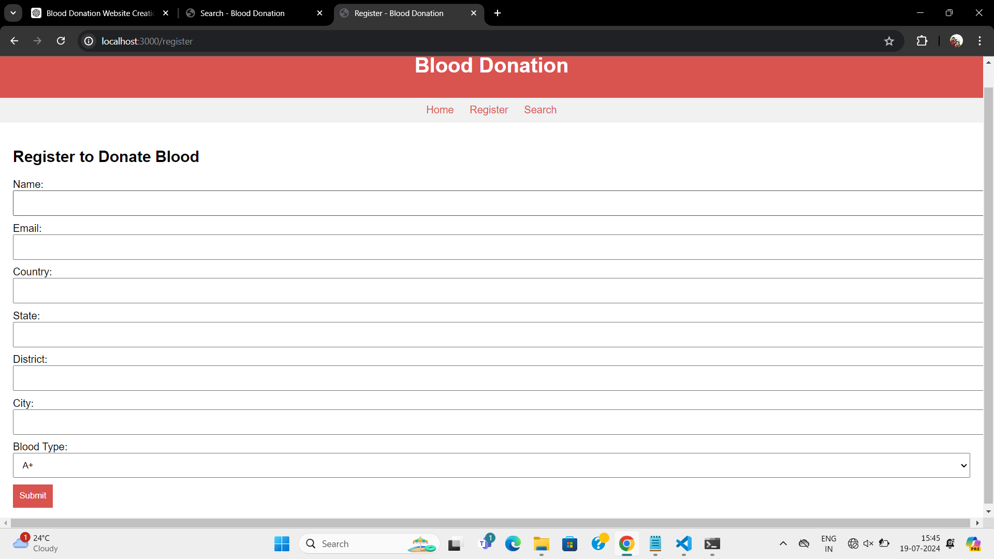

Slide 10
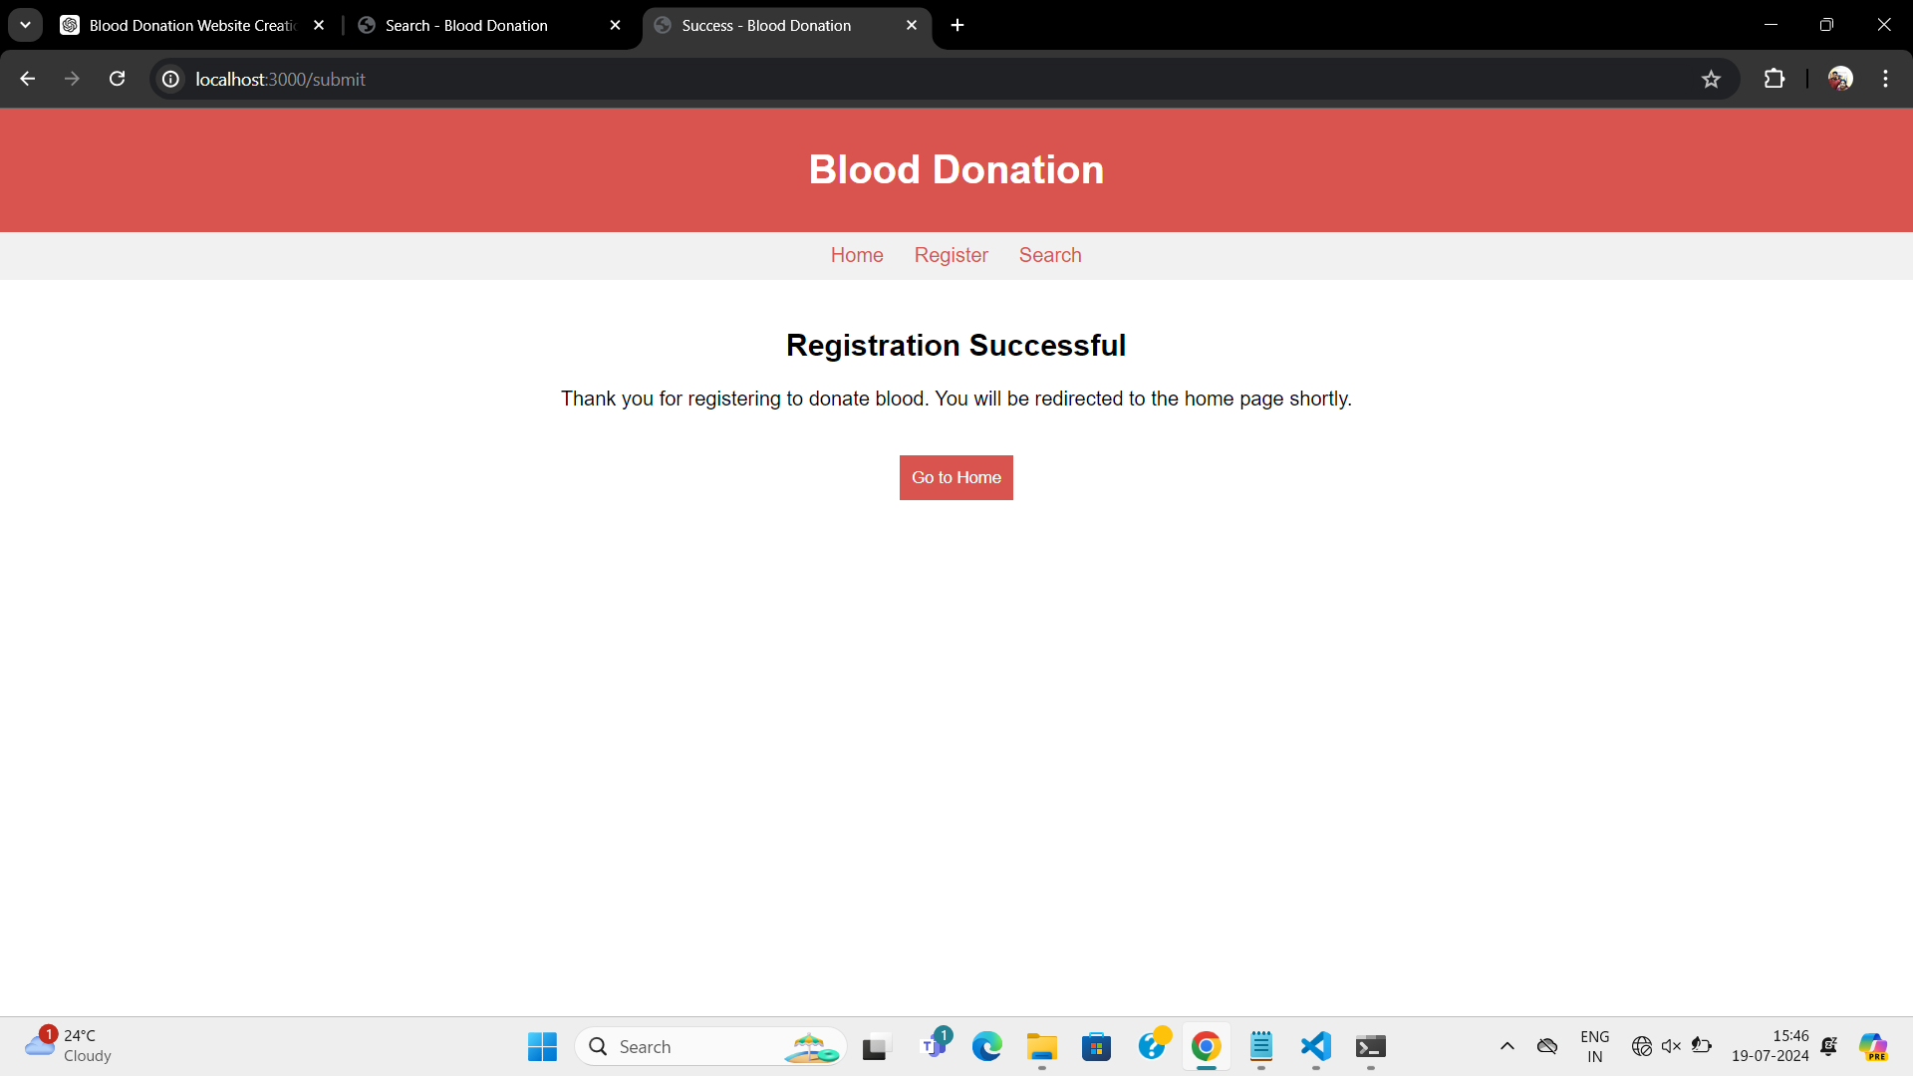

Slide 11
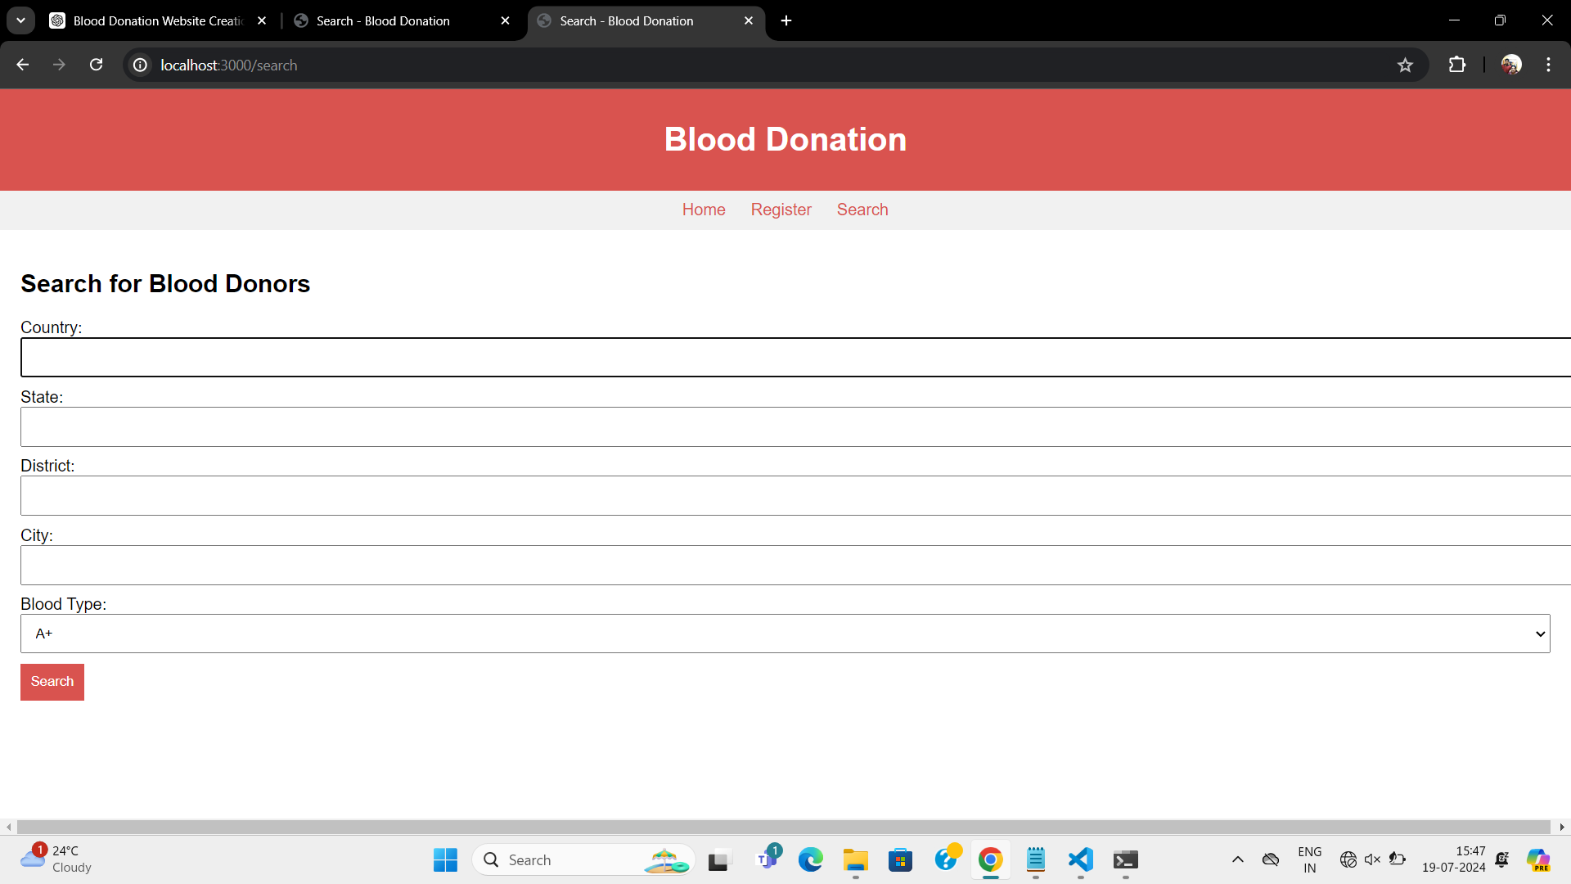

Slide 12
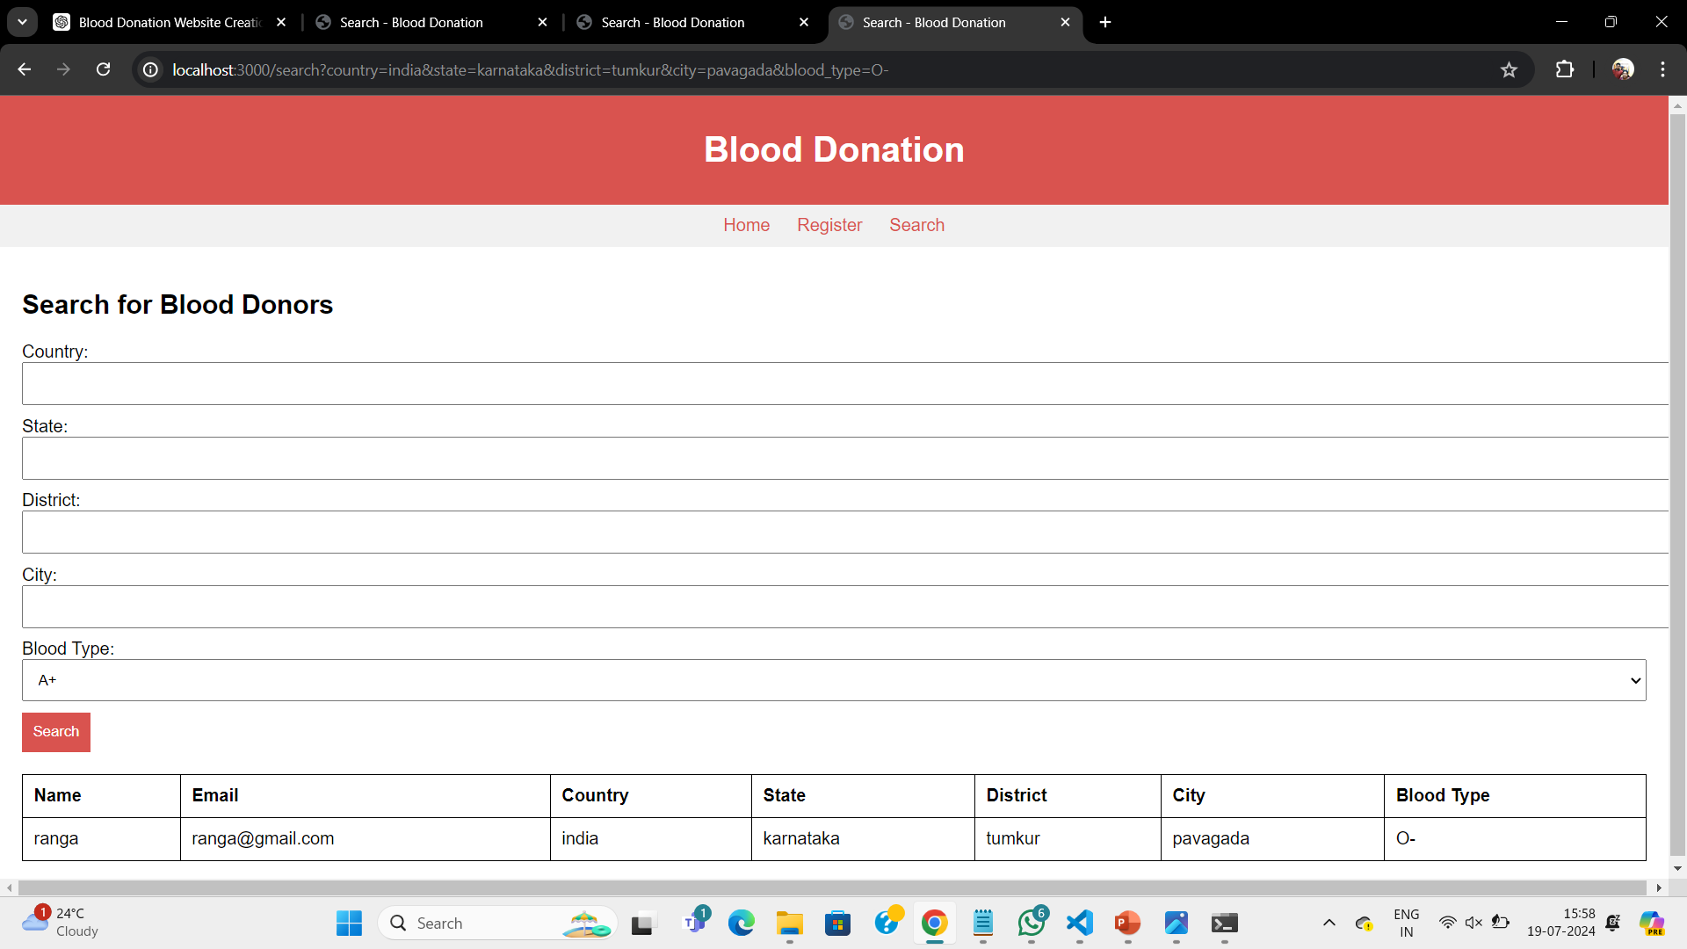

Slide 13
Conclusion
In conclusion, the Blood Connect Blood Donation website mini project aims to create a platform that bridges the gap between blood donors and recipients.
Integration of multiple donors data and accessing it as per requirement.

Slide 14
Thank you
Queries ?

